Slide 1
Assembly Language Programming Fundamentals
Presented By: Shehrevar Davierwala
Do Visit: http://sites.google.com/site/techwizardin http://www.authorstream.com/shehrevard

Slide 2
Introduction To Programming Languages
Machine Languages -“natural language” of a computer
Low Level Languages-In low level language, instructions are coded using mnemonics
High Level Languages

Slide 3
Data Representation & Numbering Systems
Binary Numbering Systems
Octal Numbering Systems
Decimal Numbering Systems
Hexadecimal Numbering Systems

Slide 4
Types Of Encoding
American Standard Code For Information Interchange ( ASCII )
Binary Coded Decimal ( BCD )
Extended Binary Coded Decimal Interchange Code ( EBCDIC )

Slide 5
Mode of data representation
Integer Representation
Floating Point Representation

Slide 6
Format of Assembly Language Instructions
[Label] Operation [Operands] [; Comment]
Example: Examples of instructions with varying numbers of fields.
[Label] Operation [Operands] [; Comment]
L1: cmp bx, cx ; Compare bx with cx all fields present
add ax, 25 operation and 2 operands
inc bx operation and 1 operand
ret operation field only
; Comment: whatever you wish !! comment field only

Slide 7
program syntax
Type 1( MASM) | TYPE 2(MASM) | Kit
.model small .data Mes db ‘Hello $’ Op1 db 20h Op2 db 30h .code Start: Mov ax,@data Mov ds,ax Mov ax,op1 Mov bx,op2 Add ax,bx Int 3 End start | Assume CS:code segment,DS:Data segment DATA SEGMENT Mes db ‘Hello $’ Op1 db 20h Op2 db 30h DATA ENDS CODE SEGMENT Start: Mov ax,data Mov ds,ax Mov ax,op1 Mov bx,op2 Add ax,bx Int 3 CODE ENDS End start | Mov ax,20 Mov bx,30 Add ax,bx Int 3

Slide 8
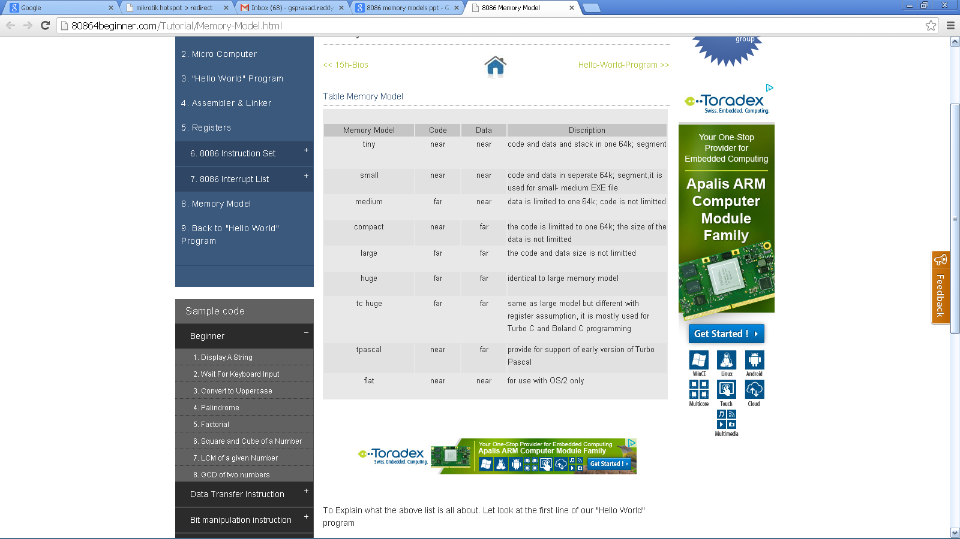

Slide 9
Assembler Directives
Procedures
Macros

Slide 10
Assembler Directives
Assembler Directives are directions to the assembler.
Assembler directives are the commands to the assembler that direct the assembly process.
They indicate how an operand is treated by the assembler and how assembler handles the program.
They also direct the assembler how program and data should be arranged in the memory.

Slide 11
List of Assembler Directives
ASSUME | DB | DW | DD | DQ
DT | END | ENDP | ENDS | EQU
EVEN | EXTRN | GLOBAL | GROUP | INCLUDE
LABEL | LENGTH | NAME | OFFSET | ORG
PROC | PTR | SEGMENT | SHORT | TYPE

Slide 12
Procedures
A procedure is a collection of instructions to which we can direct the flow of our program, and once the execution of these instructions is over control is given back to the next line to process of the code which called on the procedure.
At the time of invoking a procedure the address of the next instruction of the program is kept on the stack so that, once the flow of the program has been transferred and the procedure is done, one can return to the next line
of the original program, the one which called the procedure.
Intrasegment procedure(IP in stack)
Intersegment procedure(CS:IP in stack)

Slide 13
Syntax:
Procedure name PROC near
instruction 1
instruction 2
RET
Procedure name ENDP
Example:
ADD2 PROC near
ADD AX,BX
RET
ADD2 ENDP
ADD2 PROC FAR
ADD AX,BX
RET
ADD2 ENDP

Slide 14
MACROS
A macro is a group of repetitive instructions in a program which are codified only once and can be used as many times as necessary.
Macro with in a macro is a nested MACRO
A macro can be defined anywhere in program using the directives MACRO and ENDM

Slide 15
Syntax of macro:
  Read MACRO
  mov ah,01h
  int 21h
  ENDM
  Display MACRO
  mov dl,al
  Mov ah,02h
  int 21h
  ENDM

Slide 16
Passing parameters to a macro
Display MACRO MSG
mov dx, offset msg
mov ah,09h
int 21h
ENDM
The parameter MSG can be replaced by msg1 or msg2 while calling…
Calling macro:
DISPLAY MSG1
DISPLAY MSG2
MSG1 db “I am Fine $”
MSG2 db “Hello, How are you..? $”
Here parameter is MSG

Slide 17
Procedures Vs Macros
Procedures | Macros
Accessed by CALL and RET mechanism during program execution | Accessed by name given to macro when defined during assembly
Machine code for instructions only put in memory once | Machine code generated for instructions each time called
Parameters are passed in registers, memory locations or stack | Parameters passed as part of statement which calls macro
Procedures uses stack | Macro does not utilize stack
A procedure can be defined anywhere in program using the directives PROC and ENDP | A macro can be defined anywhere in program using the directives MACRO and ENDM
Procedures takes huge memory for CALL(3 bytes each time CALL is used) instruction | Length of code is very huge if macro’s are called for more number of times

Slide 18
Key common aspects for any programming language
Variables: declaration
Assignment: assigning values to variable
Input/output: displaying messages or displaying variable values
Control Flow: If Then, Loops
Sub Programs: Definition , usage

Slide 19

Declaring Variables
In c , java data types are used
In Assembly language, Assembler Directives
are used(db , dw , dd , dq , dT)
Example:
      reply db ‘y’ ( reply is a character variable)
      prompt db ‘Enter your favourite colour: ’, 0( prompt is a string terminated by null)
      colour db 80 dup(?) (colour is an array of size 80)
      i db 20
      k db ?
      num dw 4000
      large dd 50000

Slide 20
Indirect addressing
  Strings stored in memory
  Message db ‘Hello’,0

Slide 21
8086 stack
The stack is a block of memory that may be used for temporarily storing the contents of registers inside CPU.
Stack is accessed by using SP and SS.
Stack is a Top Down Data Structure whose elements are accessed by using a pointer (SP,SS).
The stack is required when CALL instruction is used.
Push
Pop
Top of stack
Stack pointer
LIFO

Slide 22
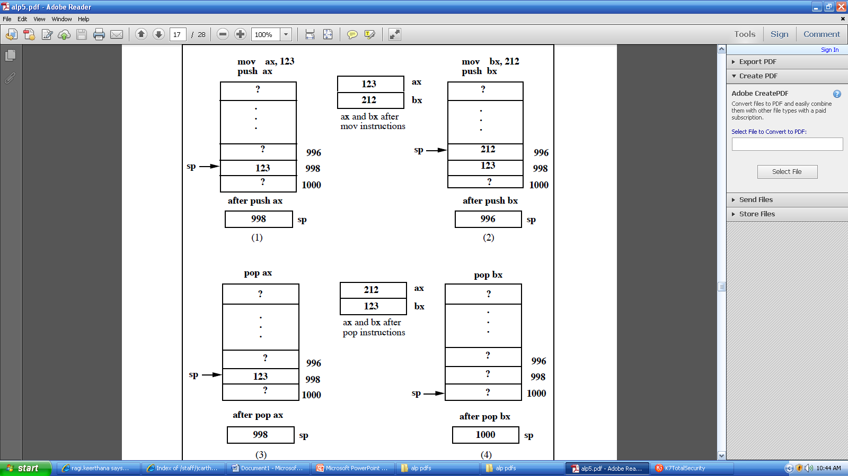
stack

Slide 23
Example: Using the stack, swap the values of the ax and bx registers, so that ax now contains what bx contained and bx contains what ax contained. (This is not the most efficient way to exchange the contents of two variables). To carry out this operation, we need at least one temporary variable:
push ax ; Store ax on stack
push bx ; Store bx on stack
pop ax ; Copy last value on stack to ax
pop bx ; Copy first value to bx
Push ax
Mov ax,bx
popbx

Slide 24
Assignment
For assigning values, MOV
    Mov ax,42
    Mov bx,45
    So here MOV instruction carries out assignment
    Syntax of MOV: MOV destination, source
    Destination – a register or memory location
    Source- - a constant or another register or memory location.

Slide 25
Example1: Store the ASCII code for the letter A in register bx.
Ans: ????
Comments: we can give comments with help of semicolon(;).the text written after semicolon is treated as semicolon.
Add ax,bx; addition of ax,bx contents
Note: In assembly language, only one Arithmetic operation can be performed at a single time.

Slide 26
Exercises
1) Write instructions to:
  Load character ? into register bx
  Load space character into register cx
  Load 26 (decimal) into register cx
  Copy contents of ax to bx and dx
2) What errors are present in the following :
    mov ax 3d
    mov 23, ax
    mov cx, ch
    move ax, 1h
    add 2, cx
    add 3, 6
    inc ax, 2
3) Write instructions to evaluate the arithmetic expression 5 +(6-2) leaving the result in ax using (a) 1 register, (b) 2 registers,(c) 3 registers
4) Write instructions to evaluate the expressions:
    a = b + c –d
    z = x + y + w – v +u

Slide 27
Input / output
i/o devices—keyboard , screen
IN & OUT( complicated instructions)
So a mechanism is needed to call operating system to carryout I/O .
Also what kind of I/O operation to be performed should be specified.( read or write etc)
Here we do it with help of SOFTWARE INTERRUPTS

Slide 28
SOFTWARE INTERRUPT
Software interrupt is generated by program
The INT instruction generates a software interrupt
INT instruction uses a single operand to indicate which MS-DOS sub program should be invoked.
FOR I/O operations, We have INT 21H
Here number stored in AH register is used to specify which kind of I/O operation is to be done.

Slide 29
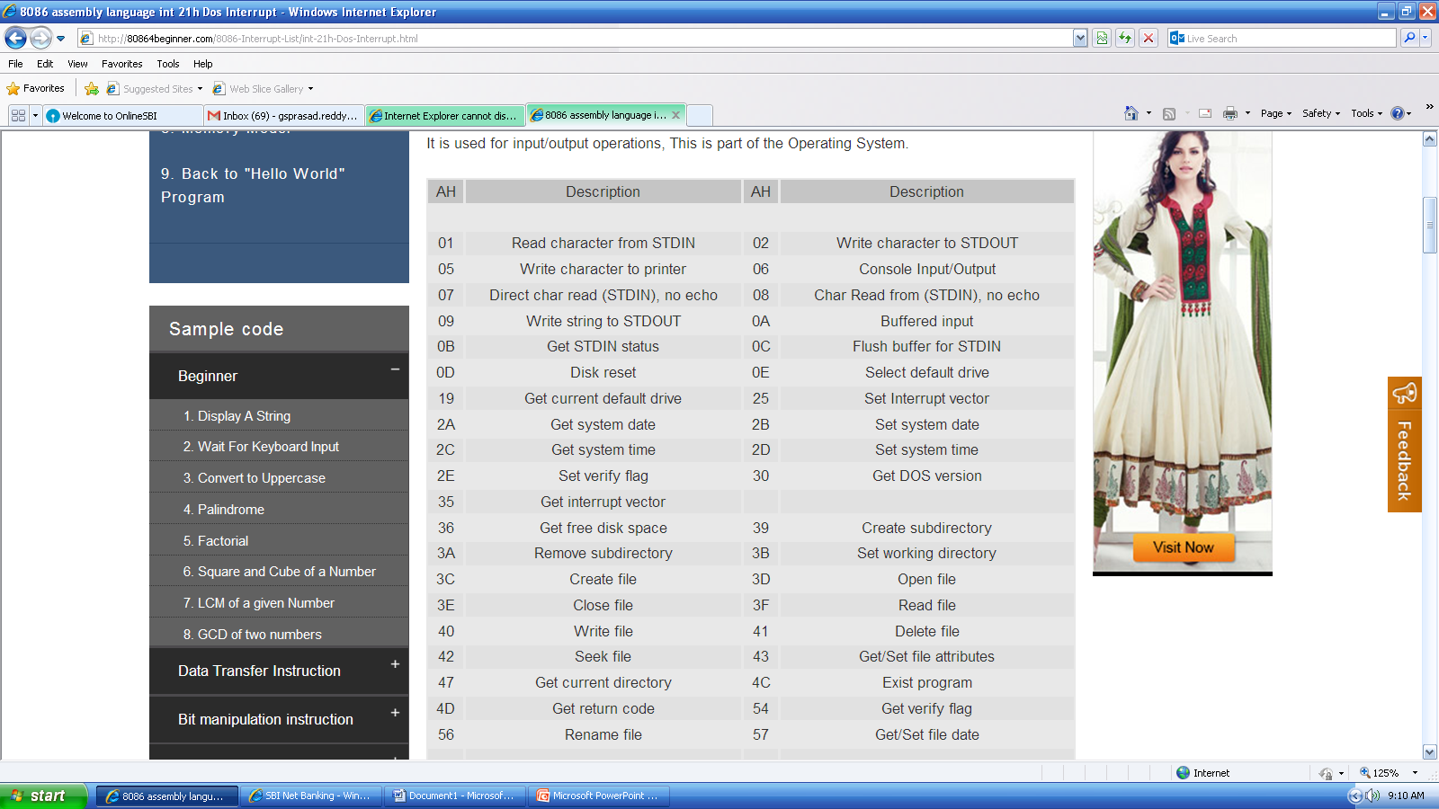
1h

Slide 30
Write a code fragment to display the character ’a’ on the screen?
Write a code fragment to read a character from the keyboard?
Reading and displaying a character?

Slide 31
Example: The following code fragment illustrates the use of indirect addressing. It is a loop to count the number of characters in a string terminated by the Null character (ASCII 0). It uses the cx register to store the number of characters in the string.
    message db ‘Hello’, 0
    mov cx, 0 ; cx stores number ofcharacters
    mov bx, offset message ; store address of message in bx
    begin:
      cmp byte ptr [bx], 0 ; is this end of string?
      je fin ; if yes goto Finished
        inc cx ; cx = cx + 1
        inc bx ; bx points to next character
        jmp begin
      fin:

Slide 32
Control Flow
Example : This example illustrates the use of the jmp instruction to implement an endless loop – not something you would noramlly wish to do!
again:
call getc ; read a character
call putc ; display character
jmp again ; jump to again

Slide 33
Unconditional jump
Example : The following code fragment illustrates a forward jump, as control is transferred to a later place in the program:
call getc ; read a character
call putc ; display the character
jmp finish ; jump to label finish
<do other things>; Never gets done !!!
finish:
mov ax, 4c00h
int 21h

Slide 34
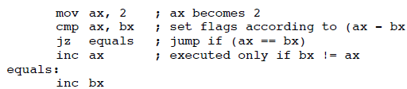
Conditional jump
conditional jump instructions can handle the various conditions (==, !=, <, >, <=, >=) that arise when comparing values. Je/jz
ax = 2;
if ( ax != bx )
{
ax = ax + 1 ;
}
bx = bx + 1 ;
mov ax, 2 ; ax = 2
sub ax, bx ; ax = 2 - bx
jz nextl ; jump if (ax-bx) == 0
inc ax ; ax = ax + 1
nextl:
inc bx

Slide 35
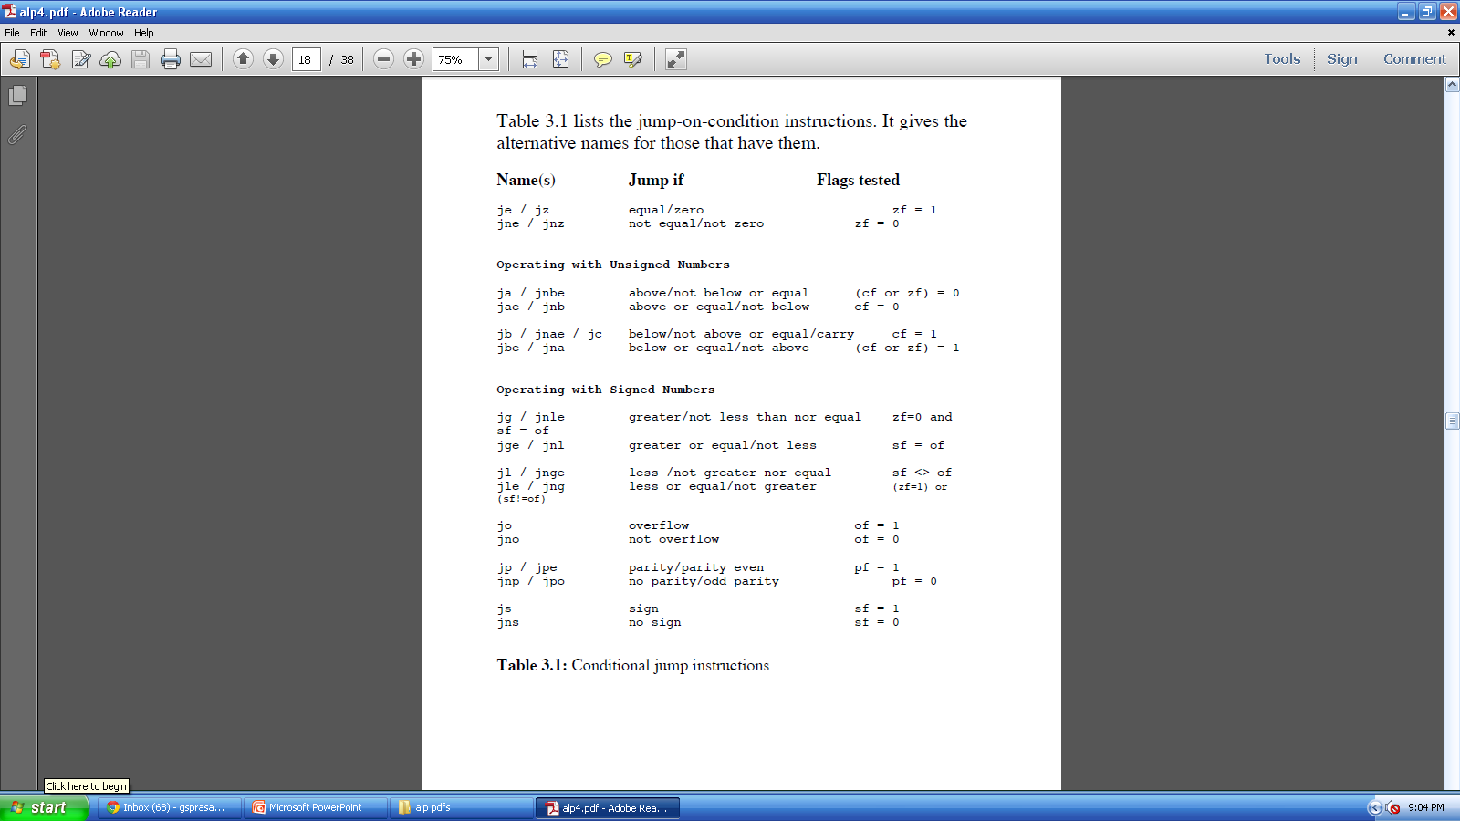
Conditional jump instructions

Slide 36
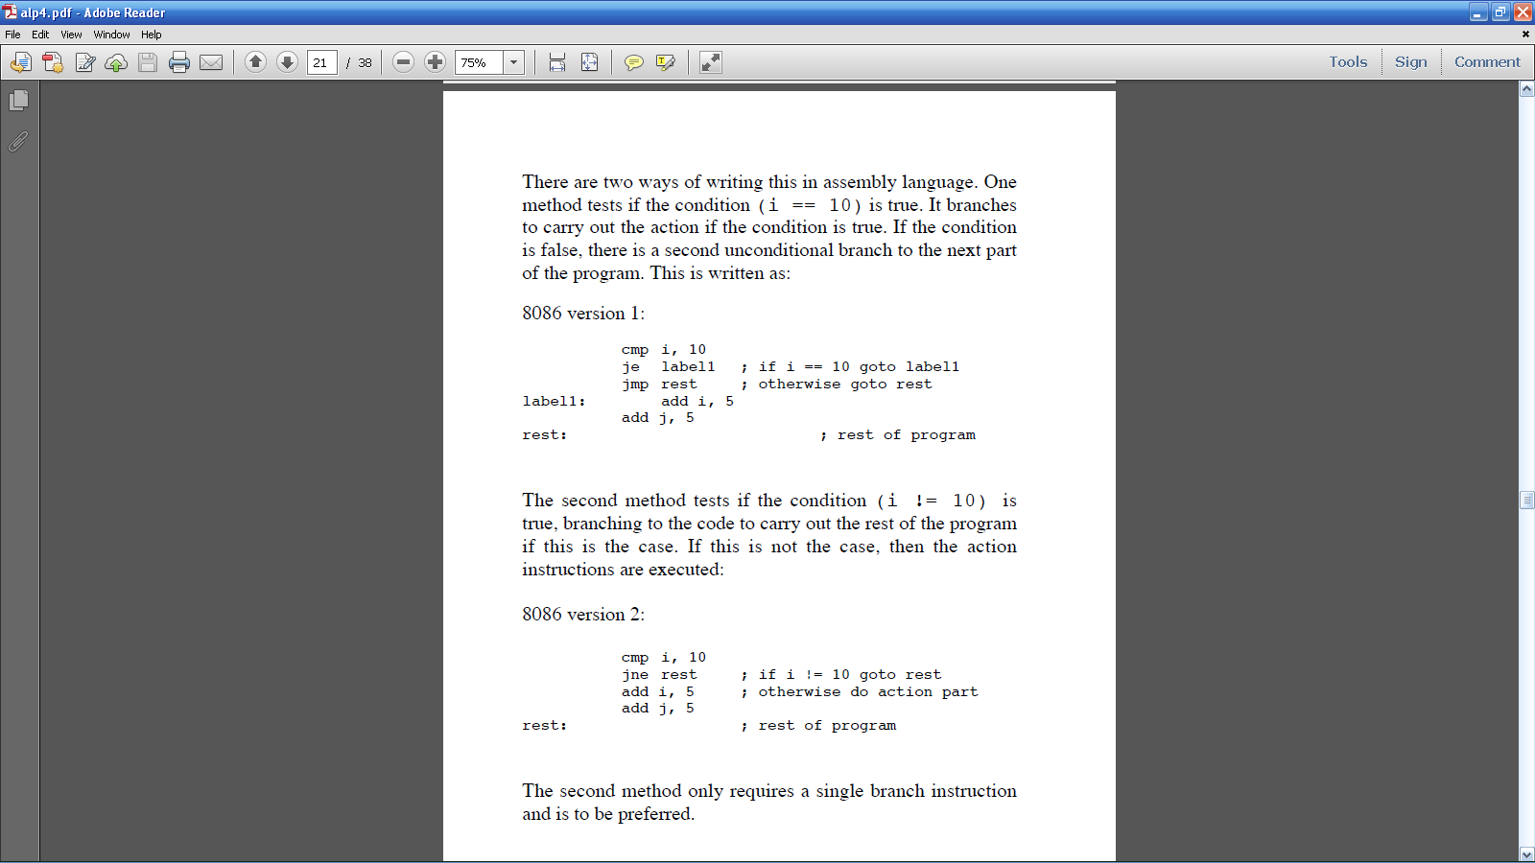
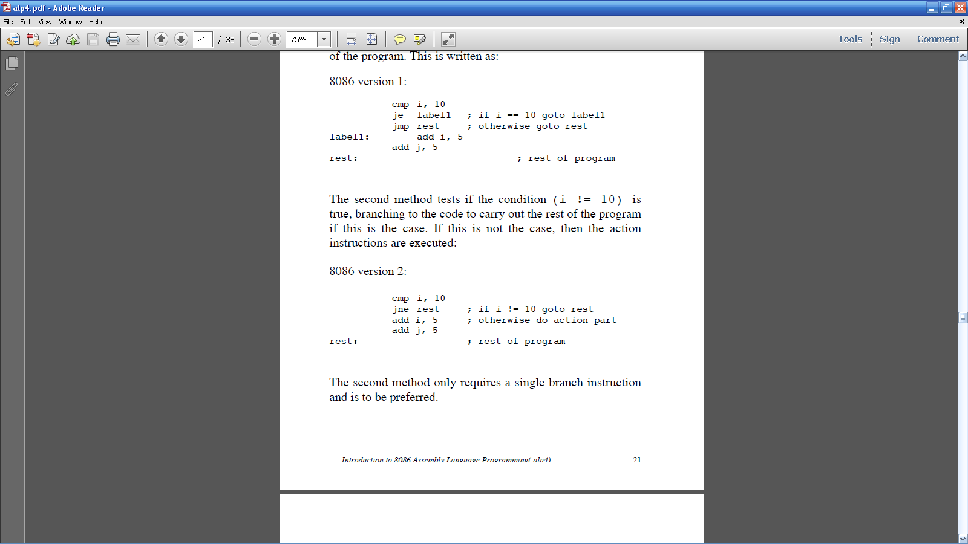
If then
if ( i == 10 )
{
i = i + 5 ;
j = j + 5 ;
}
/* Rest of program */

Slide 37
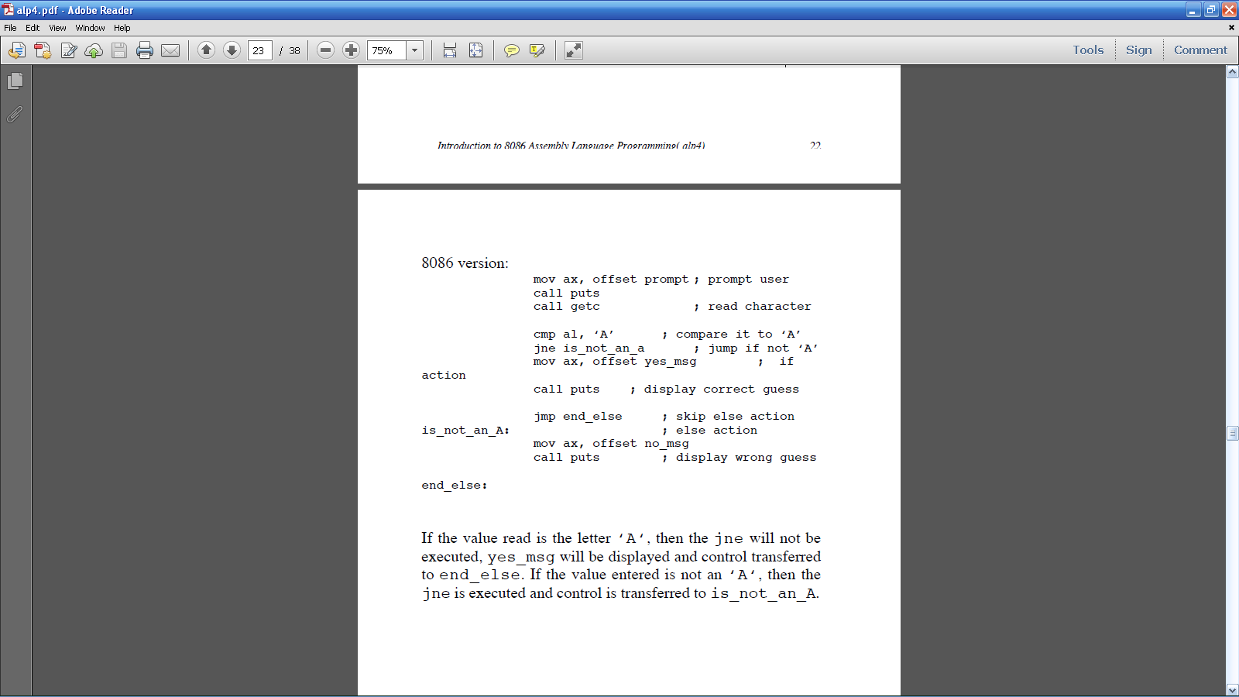
If else
c = getchar() ;
if ( c == ‘A’ )
printf(“You guessed correctly !! “);
else
printf(“Sorry incorrect guess “) ;

Slide 38
Upper case to lower case:
if ( c >= ‘A‘ && c <= ‘Z‘ ) or if ( c < ‘A‘ || c > ‘Z‘ )
main() /* char.c: convert letter to lowercase */
{
char c;
printf(“\nEnter an uppercase letter: “);
c = getchar();
if ( c >= ‘A‘ && c <= ‘Z‘ )
{
c = c + ( ‘a’ - ‘A’ ) ; /* convert to
lowercase */
printf(“\nThe lowercase equivalent is: %c “,c);
}
else
printf(“\nNot an uppercase letter %c “, c );
}

Slide 39
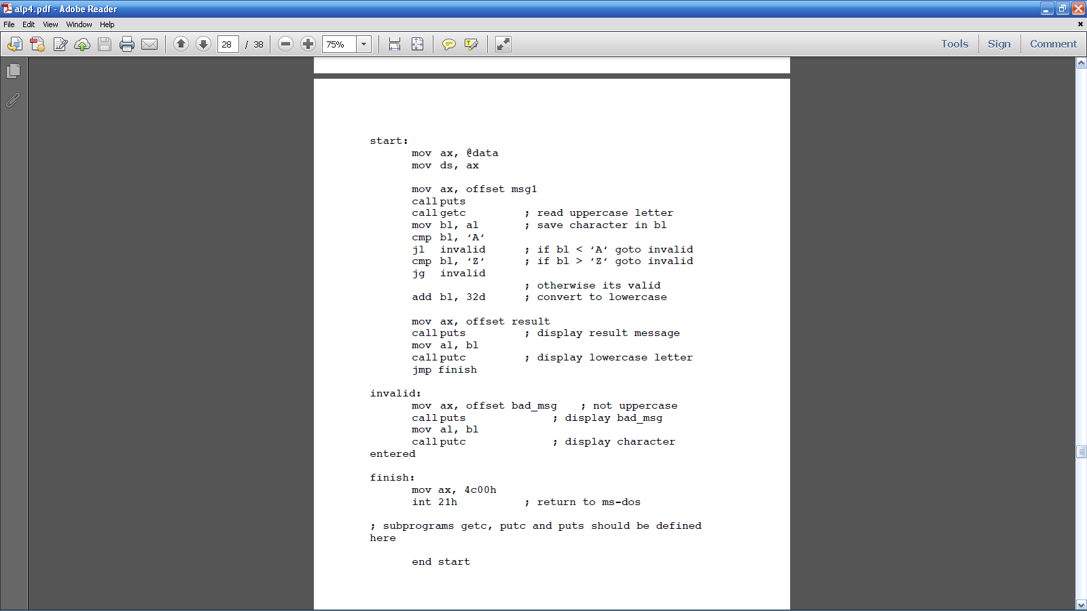

Slide 40
In the code fragments below where will execution
continue from when <jump-on-condition> is replaced by (a)
je lab1 ; (b) jg lab1; (c) jle lab1; (d) jz lab1
(i) mov ax, 10h
cmp ax, 9h
<jump-on-condition>
; rest of program
...........
...........
lab1:
(ii) mov cx, 0h
cmp cx, 0d
<jump-on-condition>
; rest of program
...........
. ..........
lab1:

Slide 41
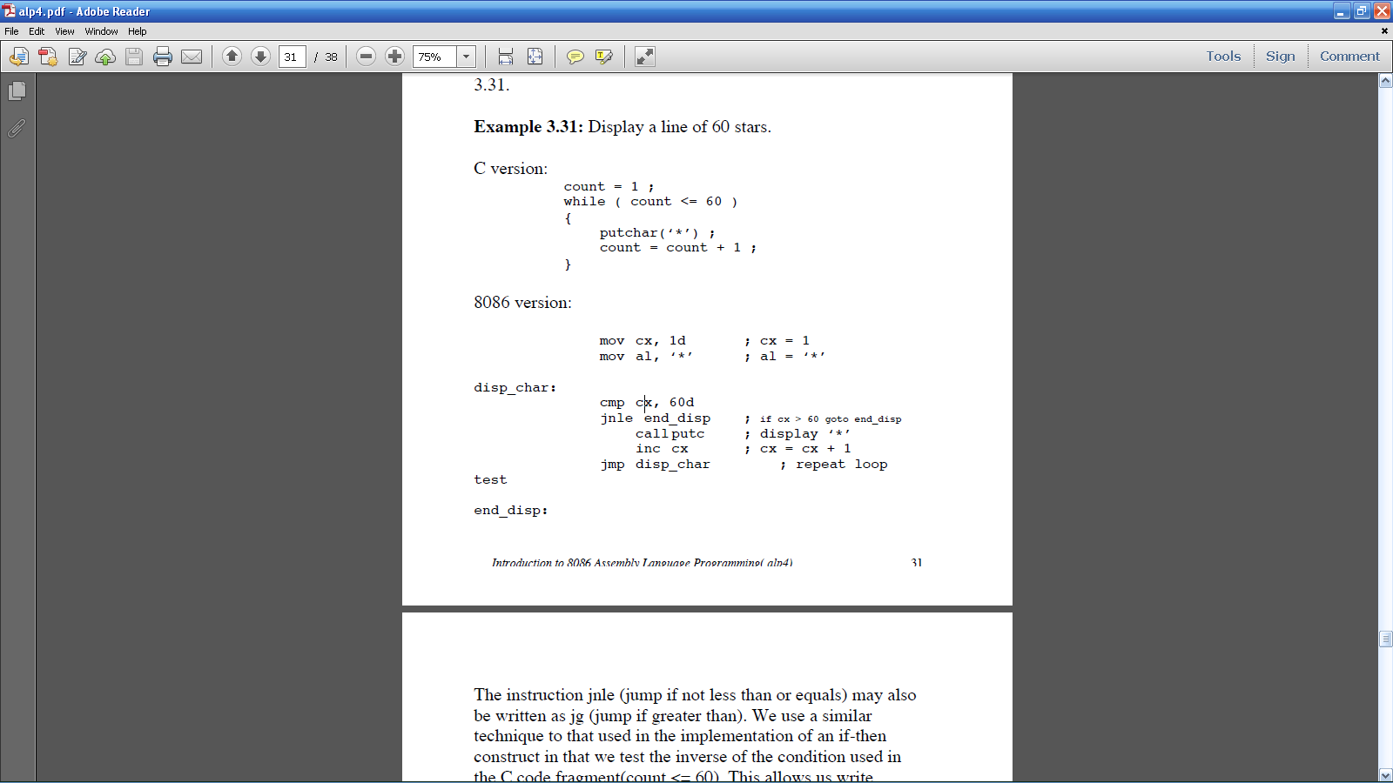
LOOPS-deterministic loop
count = 1 ;
while ( count <= 60 )
{
putchar(‘*’) ;
count = count + 1 ;
}

Slide 42
Write a code fragment to display the characters from ‘a’ to ‘z’ on the screen using the knowledge that the ASCII codes form a collating sequence. This means that the code for ‘b’ is one greater than the code for ‘a’ and the code for ‘c’ is one greater than that for ‘b’ and so on.
c = ‘a‘ ; /* c = 97 (ASCII for ‘a‘)
while ( c <= ‘z‘ )
{
putchar( c );
c = c + 1 ;
}

Slide 43
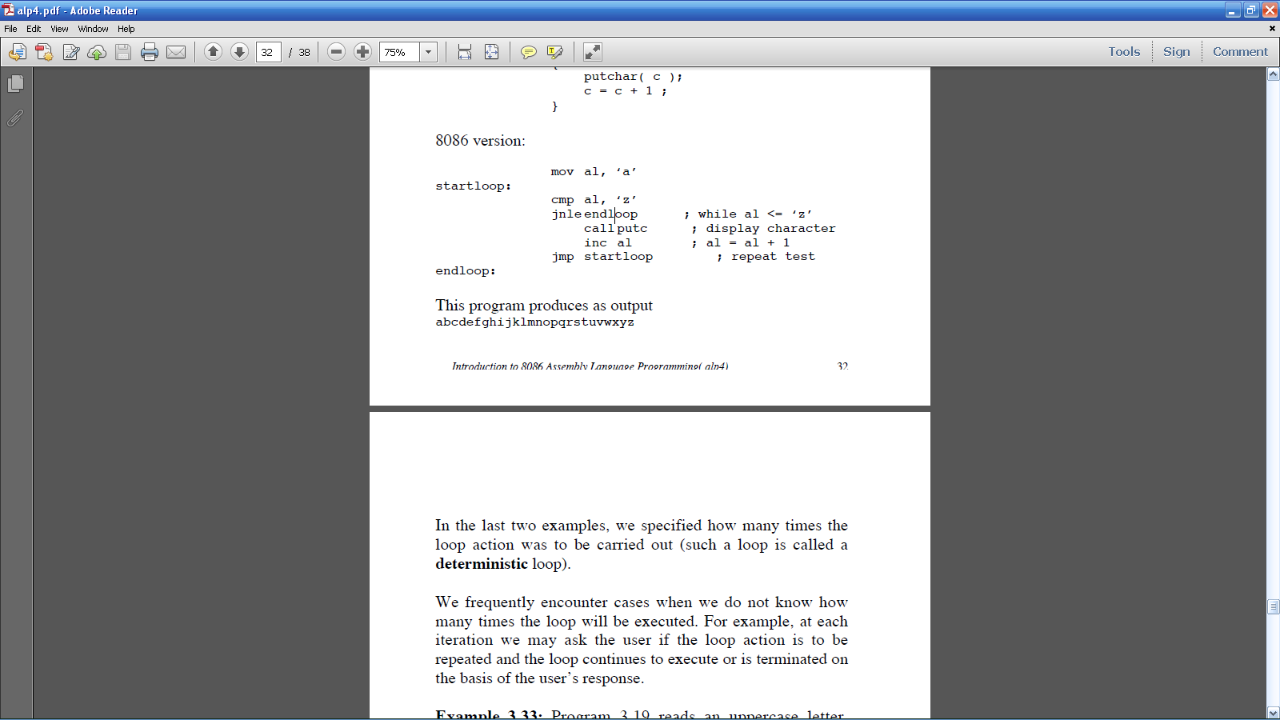

Slide 44
Non deterministic loop
main()
{
char c, reply;
reply = ‘y‘;
while ( reply == ‘y‘ )
{
printf(“\nEnter an uppercase letter: “);
c = getchar();
c = c + ( ‘a’ - ‘A’ ) ; /* convert to lowercase
*/
printf(“\nThe lowercase equivalent is: %c “, c);
printf(“\nEnter y to continue: “);
reply = getchar();
}
}

Slide 45
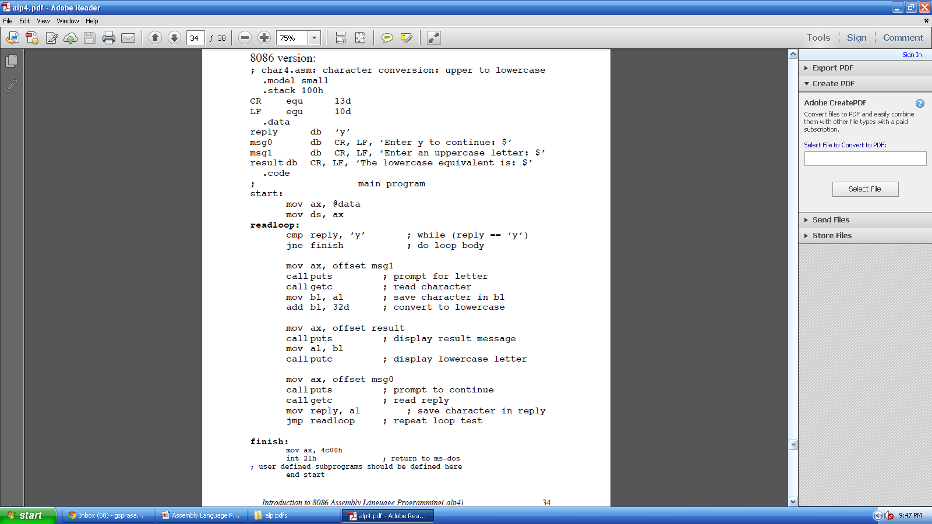

Slide 46
Bit manipulations
Nuber conversions(packed,unpacked)
Shift operations

Slide 47
Clear bit 5 of a given byte
Converting a lowercase letter to its uppercase equivalent
Specify the instructions and masks would you use to
  a) set bits 2, 3 and 4 of the ax register
  b) clear bits 4 and 7 of the bx register
How would al be affected by the following instructions:
  (a) and al, 00fh
  (b) and al, 0f0h
  (c) or al, 00fh
  (d) or al, 0f0h
  Toggle bits 0, 1 and 6 of the value in al (here 67h)
  compliment

Slide 48
or cx, cx ; compares cx with 0
je label
and ax, ax ; compares ax with 0
jg label2

Slide 49
THANK YOU
??????

